Slide 1
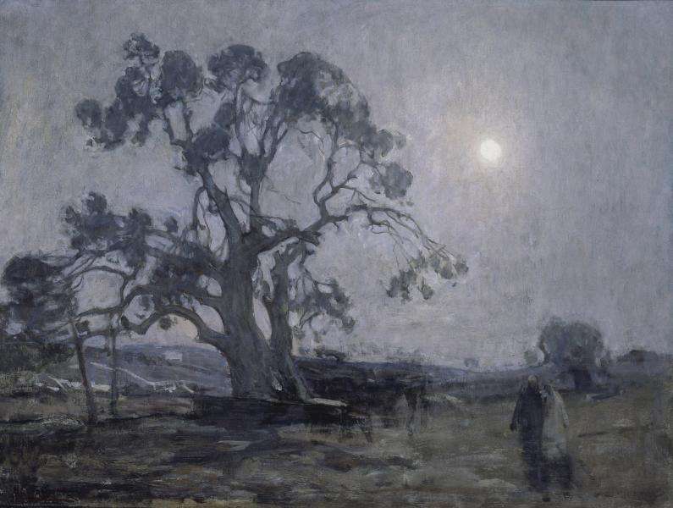
Abraham’s Oak

Slide 2
Abraham’s Oak
I chose the painting because it represents one of the places where the Africans went to worship.
The painting is also appealing to the eyes since it is true reflection of a superb art work.
I was also interested by the name since it suggested a place of worship that was used by the Africans, the oak.

